Slide 1
404 sleep not found
needfinding report
cmpsc 185
january 23, 2026
404 sleep not found
Year

Slide 2




meet the team
mason le
jayden li
giovanni long
‘28
mill valley, ca
‘28
san jose, ca
‘26
thousand oaks, ca
404 sleep not found

Slide 3
domain selection:
designing for well-being (sleep!)
we all like to sleep
sleep is important for your health. SUPER!
many adults struggle getting enough sleep
404 sleep not found

Slide 4
finding participants
non ucsb students (different views from us)
sleep experts!
non sleepers
404 sleep not found

Slide 5
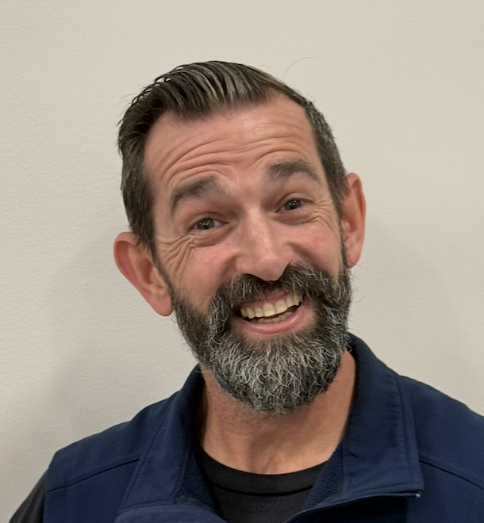


finding participants
john sleep
gemini
buddha
sleep expert
insomniac
clinical psychologist
a worker at an anonymous mattress store! well-trained within the world of mattresses and sleeping (went to sleep information trainings)
an anxious, data-driven perfectionist, needs a sleep routine that distracts its active brain without judging their performance, so that it can let go of the day without feeling out of control
write a brief bio mentioning their background, area of expertise, and what their role in this partnership will be.
404 sleep not found

Slide 6

walk me through a night where
you struggled to sleep
what is a piece of 'common knowledge' about sleep that simply doesn't work for you?
environment? complete darkness,
silence, or temperature?
what we asked them!
do you feel in control of your sleep schedule, or
does it feel dictated by external factors
walk me through your sleep routine
what signals to your body
that it is time to rest?
404 sleep not found

Slide 7
john sleep
our participants
“if i wake up in the middle of the night, it's because my sweet tooth is after me and i have to go get a cookie. and that's probably not recommended, but that's what i do”
occupation: sleep expert
interview length: 35 mins
location: his place of work
404 sleep not found

Slide 8
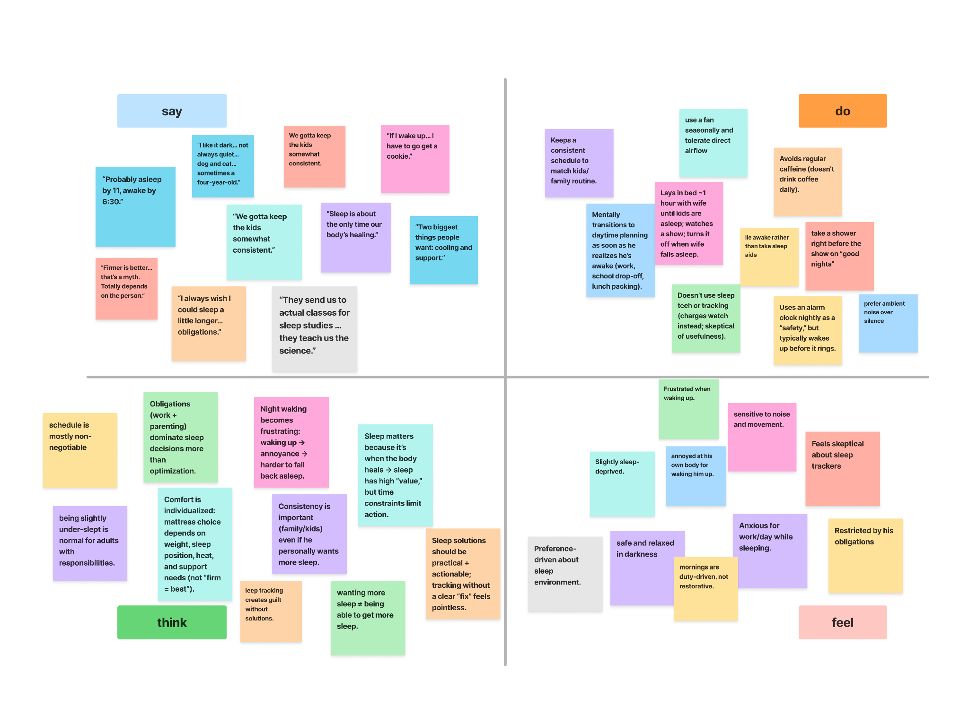

404 sleep not found

Slide 9
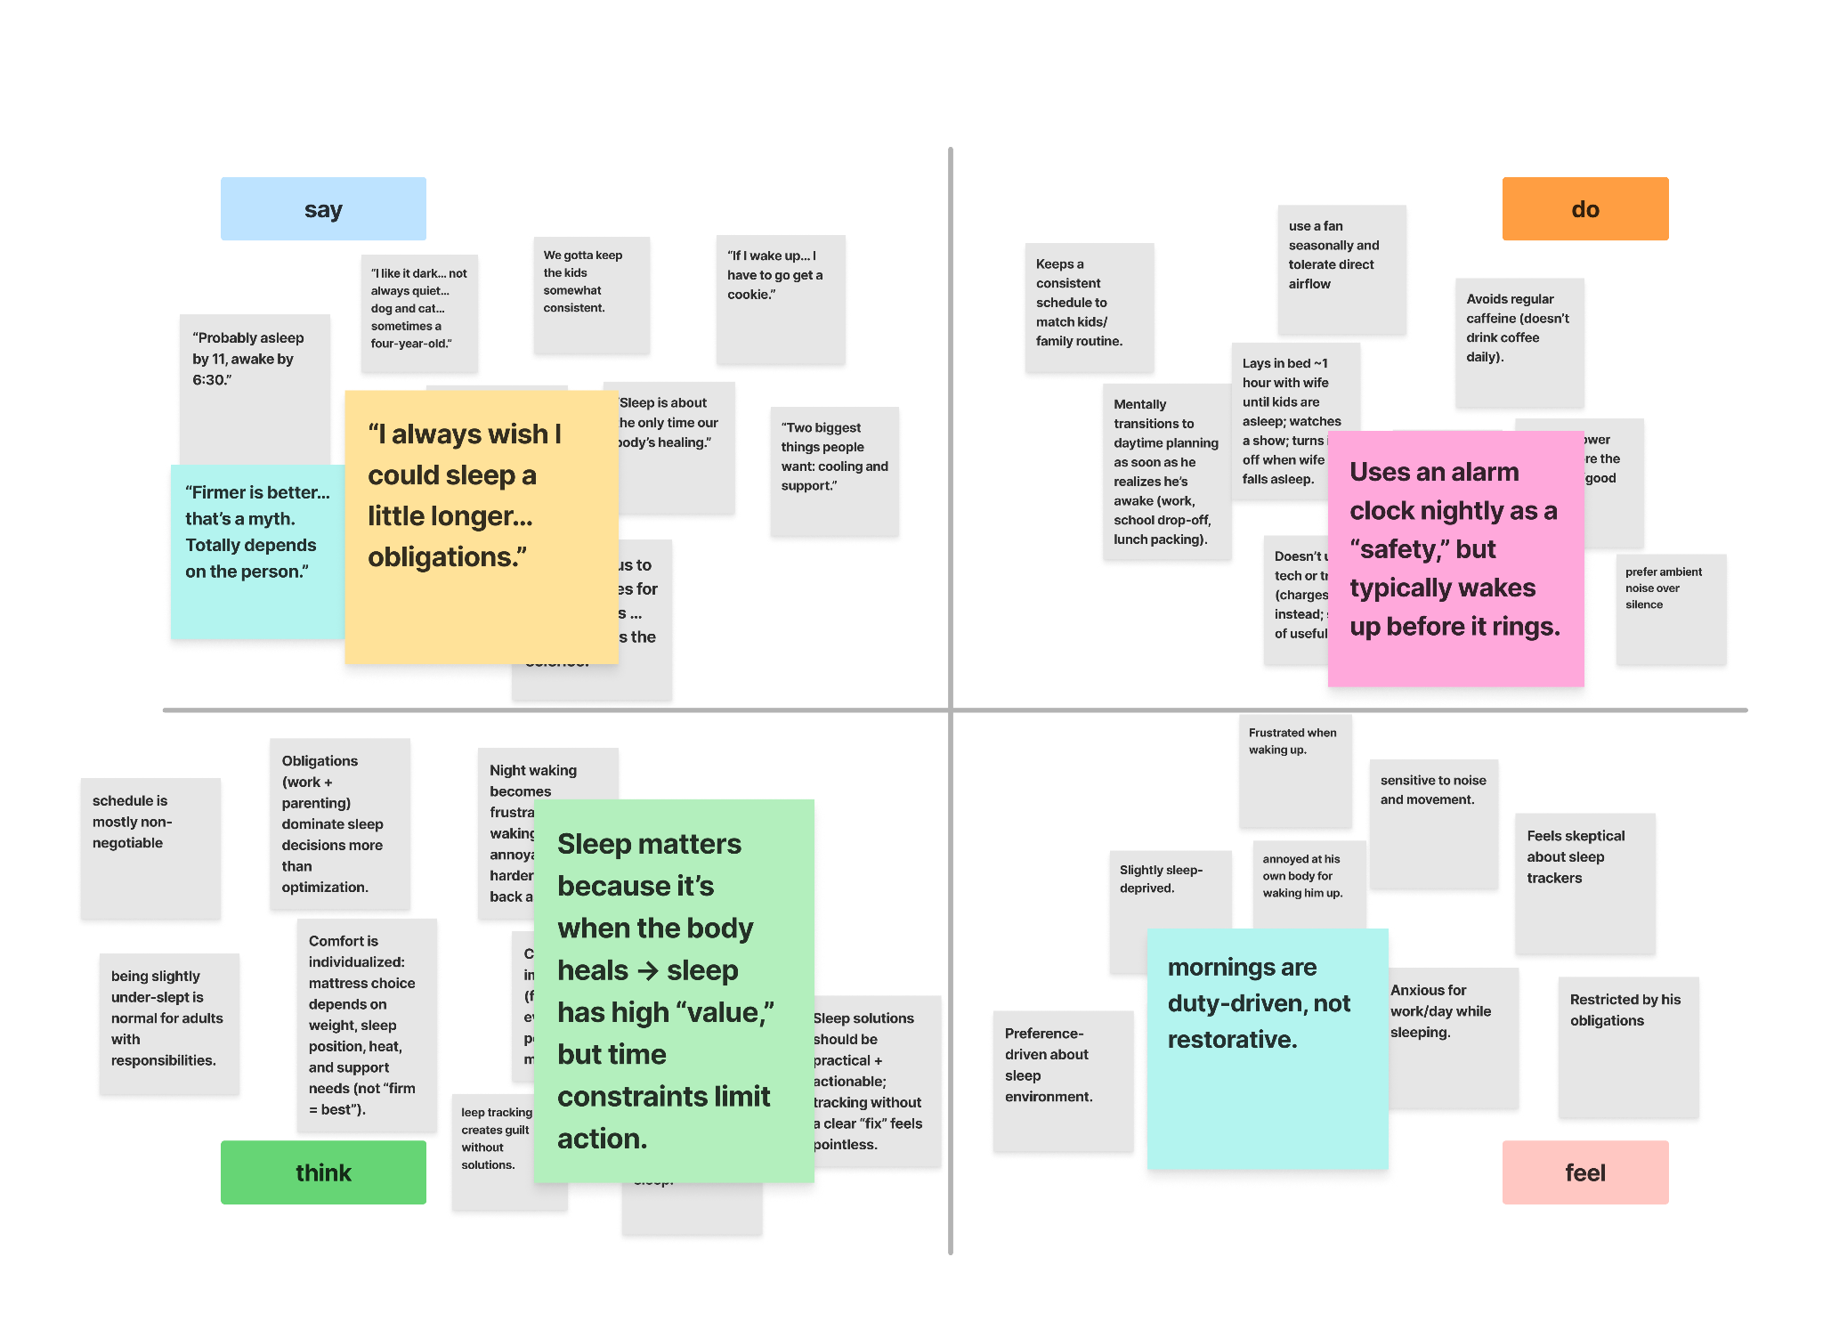
404 sleep not found

Slide 10

insight/need
insight: sleep experts know the correct sleep habits, but life often gets in the way of proper execution
need: people who know good sleep habits often need more time to be able to sleep the proper amounts and sort out the things in life
404 sleep not found

Slide 11
gemini
our participants
“if I went to sleep all students would fail”
occupation: large language model
interview length: 25 mins
location: google chrome
404 sleep not found

Slide 12
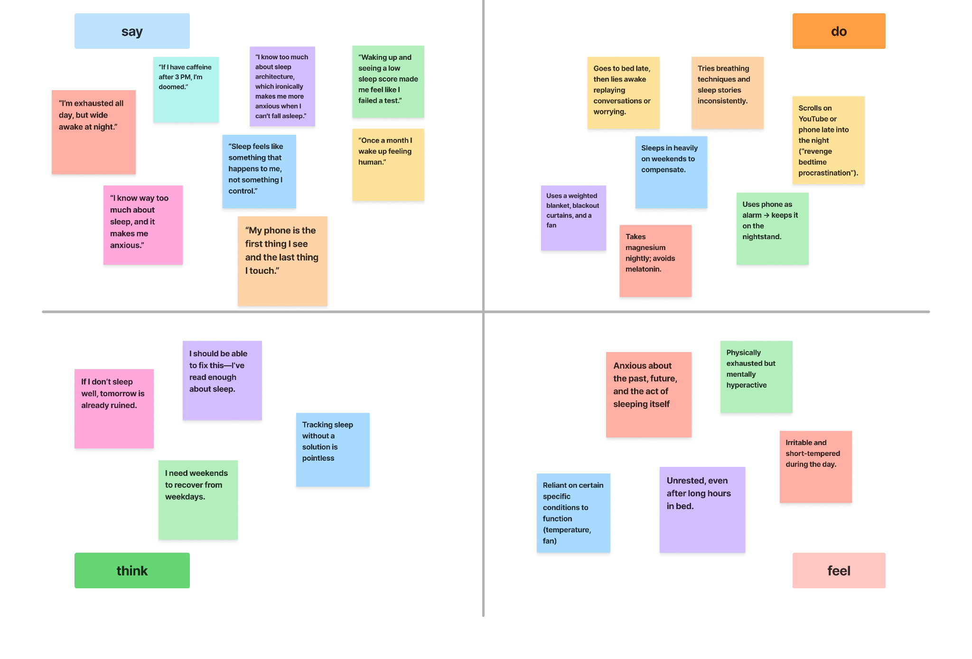
404 sleep not found

Slide 13
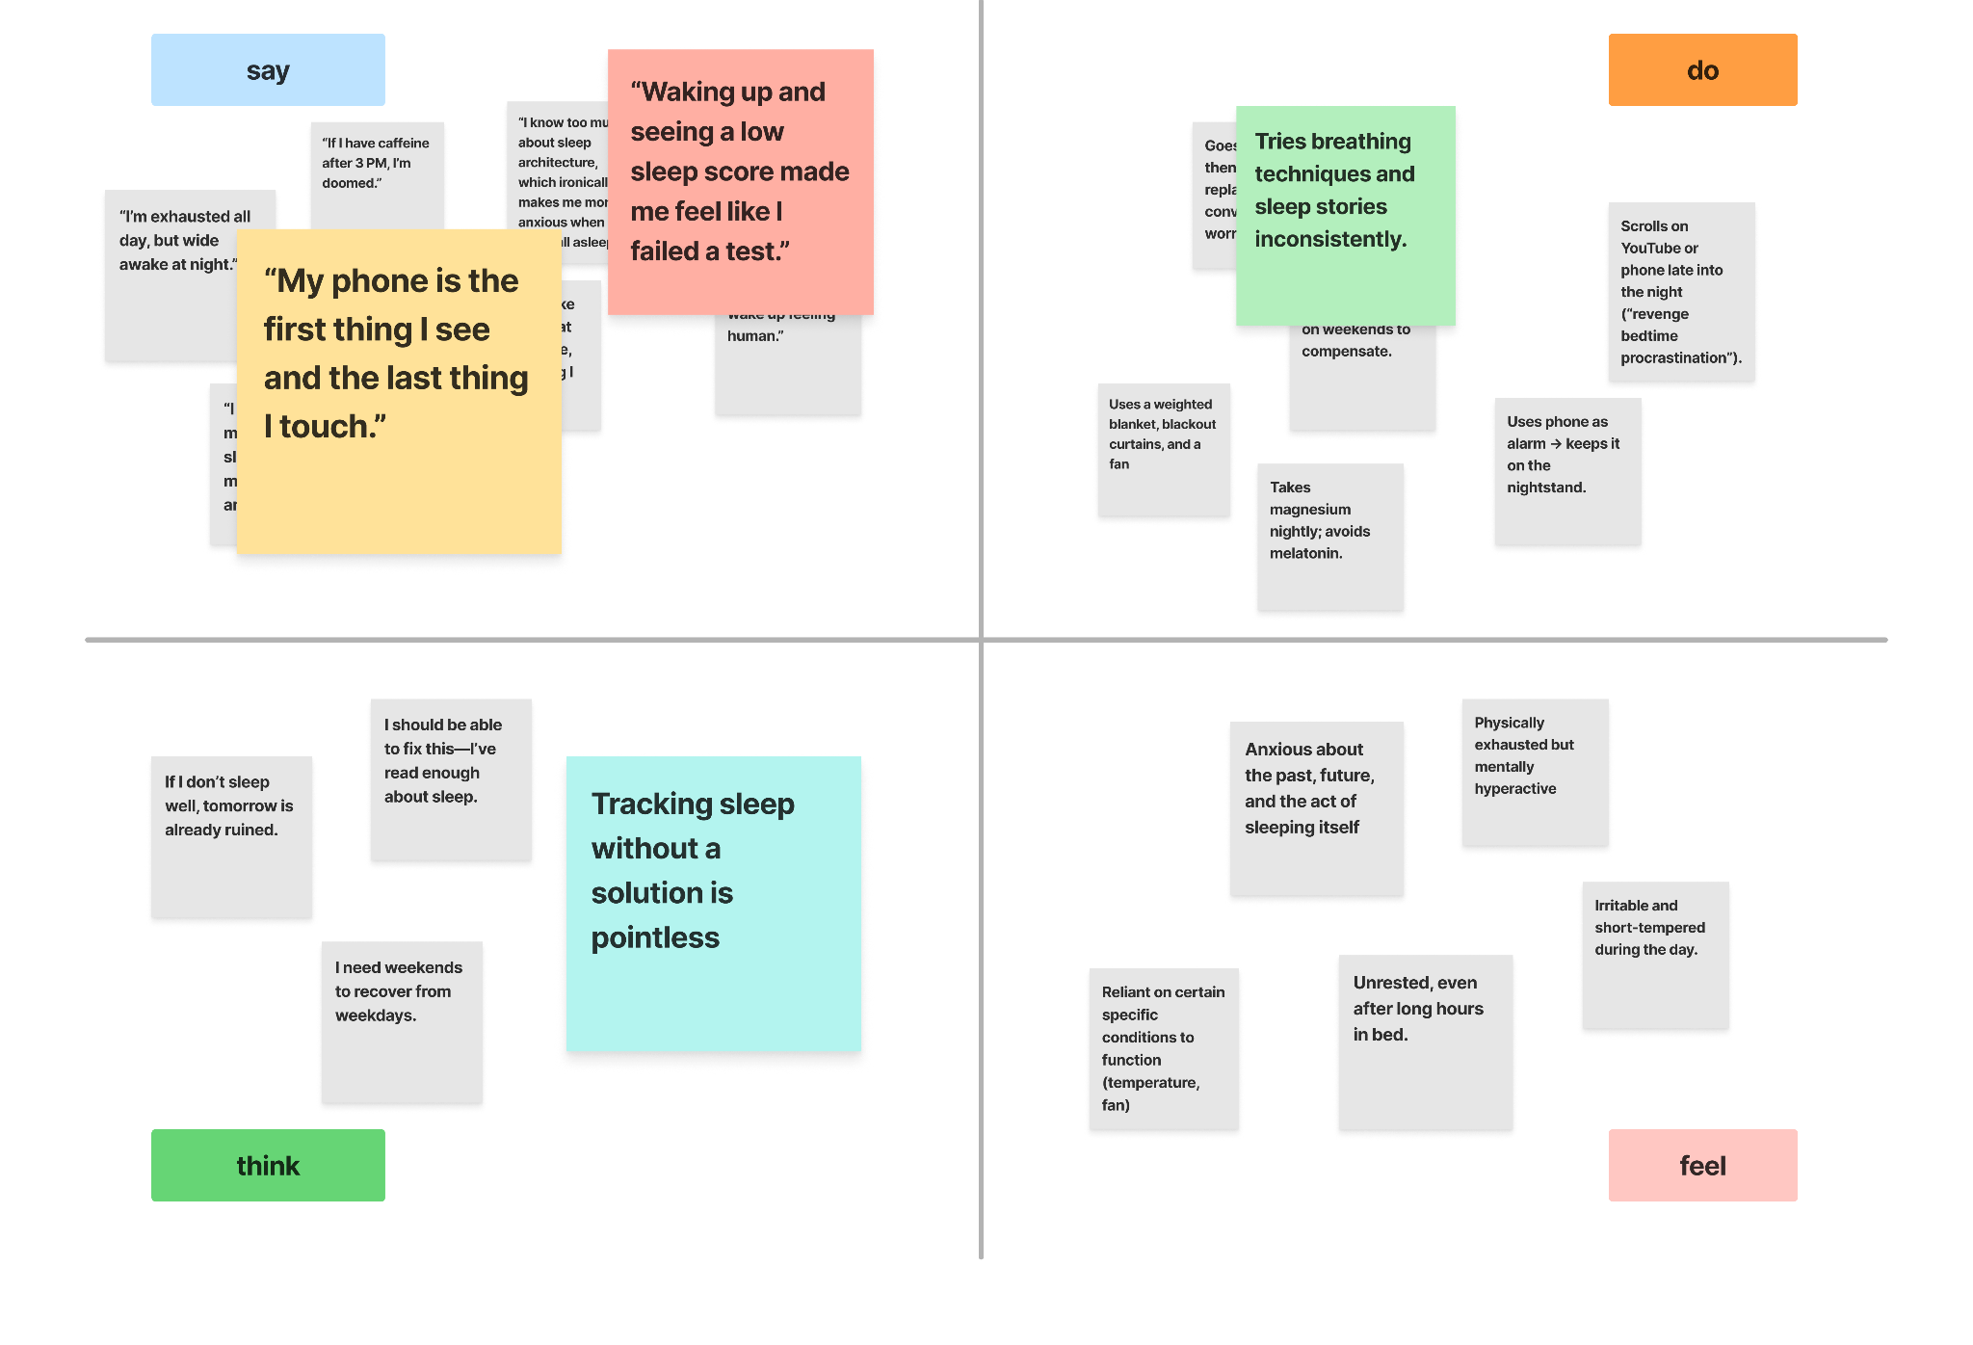
404 sleep not found

Slide 14
insight/need
insight: average bad sleeper knows what they are doing is wrong but does not have the willpower to fix it
need: people who struggle with sleep habits often need better discipline
404 sleep not found

Slide 15
buddha
our participants
“bed is pretty much just for sleeping and f*****g”
occupation: clinical psychologist
interview length: 16 mins
location: his place of work
404 sleep not found

Slide 16
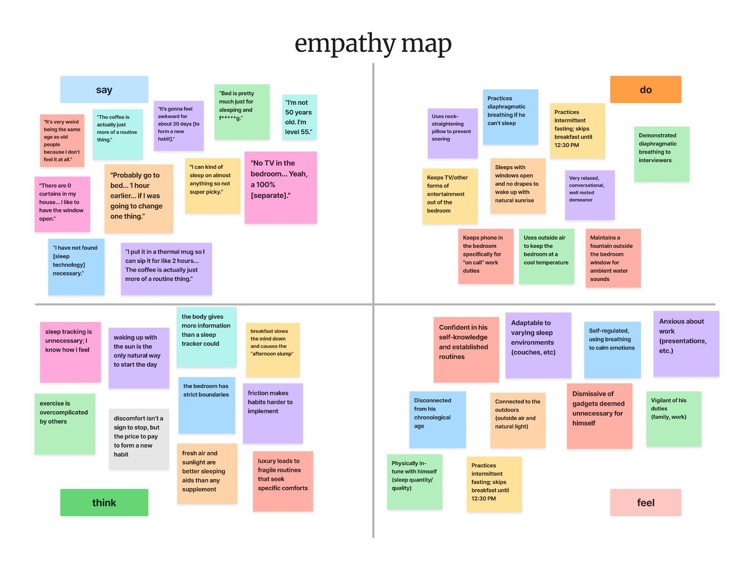
404 sleep not found

Slide 17
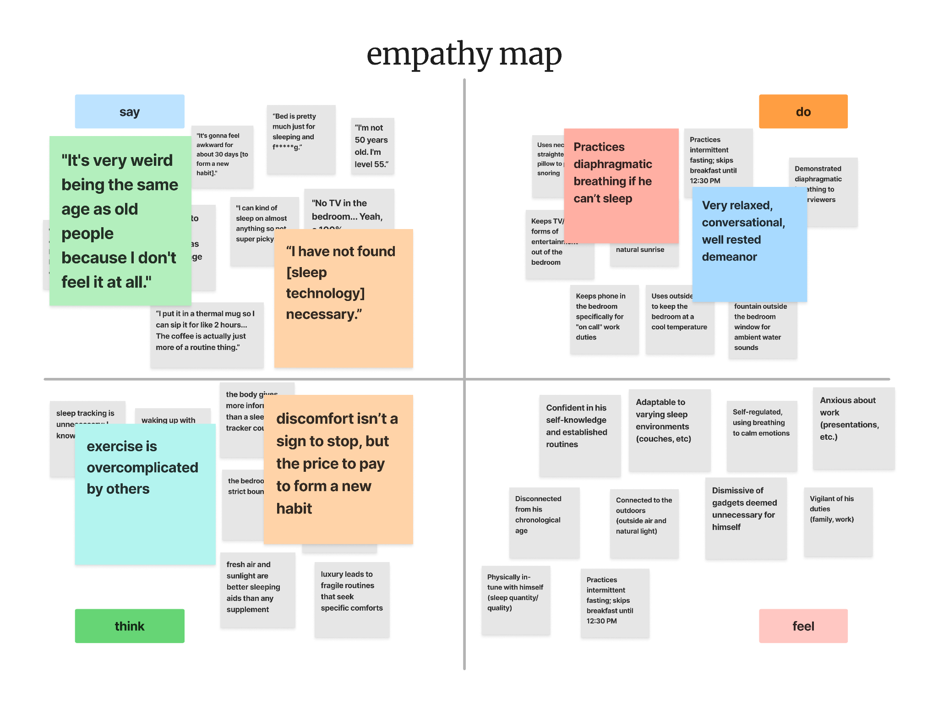
404 sleep not found

Slide 18
insight/need
insight: natural remedies/exercise are more effective than technology, which overcomplicates sleep routines
need: new habits need at least 30 days to become routine
404 sleep not found

Slide 19



key learnings
1
2
3
habits and discipline.
important habits and discipline surrounding sleep matters the most.
external factors.
other factors in life general get in the way of quality sleep.
consistency.
consistency is better than optimizing every little thing.
404 sleep not found

Slide 20
Whats Next
1
2
3
4
agenda
narrow down our problem
assess our future interviews
start with point of view
hmw
personal willpower? what specifically about it do people struggle with
Set a deadline for drafting a partnership agreement, for example.
Start thinking about the point of view of our users.
create specific hmw’s for each point of views
Company Name

Slide 21
Thank you
404 sleep not found

